Slide 1
Webdevelopment - Basics

Slide 2

The internet
Series of connected computers
ARPANET – MIT
L..O..g- (system crash)
1990-2003 Web 1.0
Internet as a commodity
2004-present Web 2.0
Global ubiquity, social media and mobile revolution

Slide 3




HTML Webpages
Browsing = requesting access to an HTML file
That file, if found, gets returned to your pc
The browser is able to interpret and render the html.

Slide 4
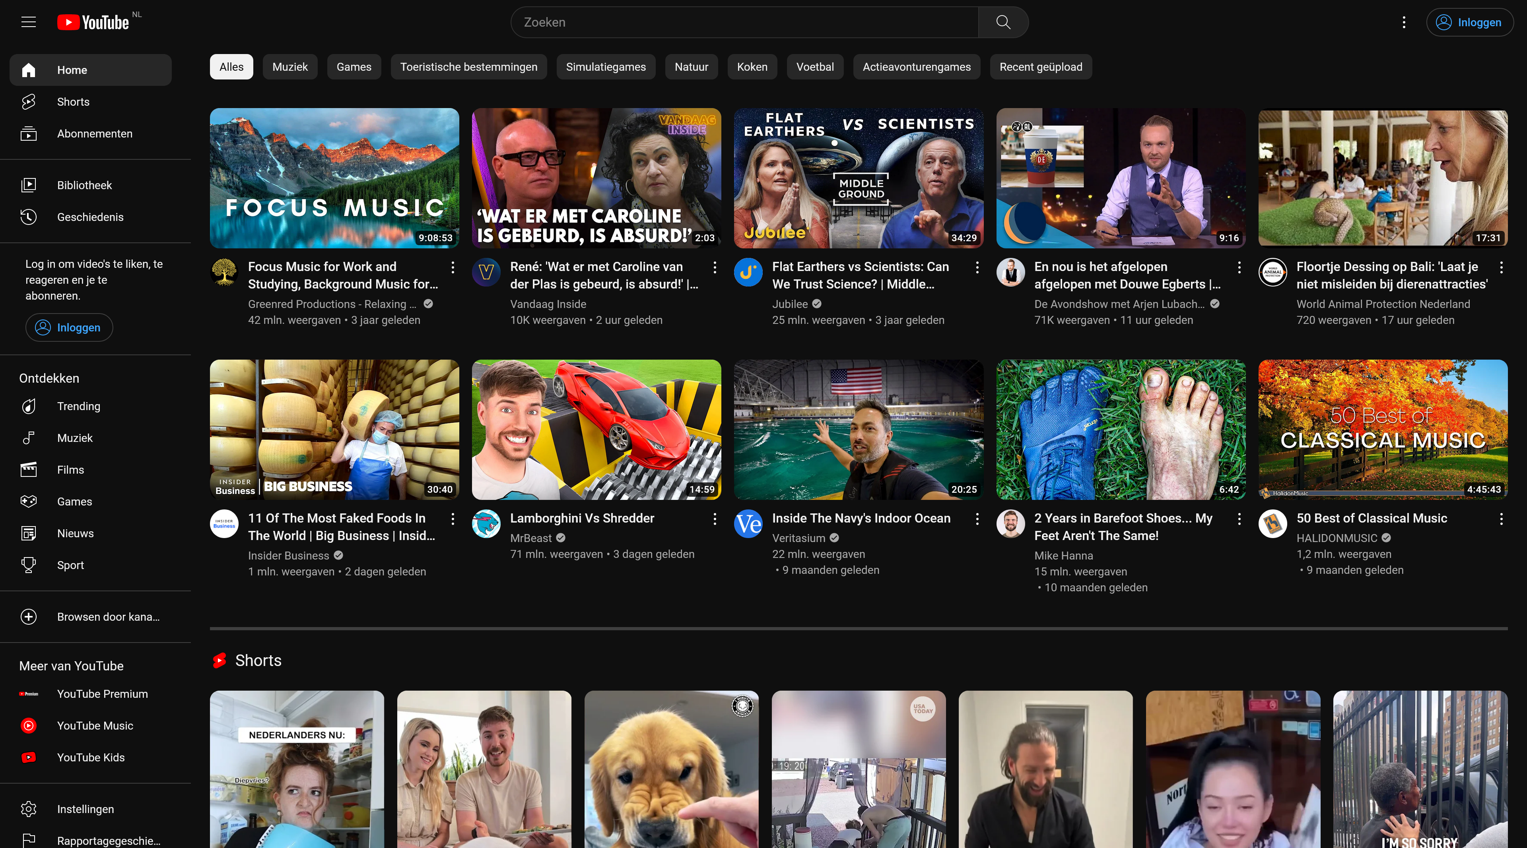

Slide 5
Webpages with PHP
Browsing = requesting access to a PHP file
The browser is not able to interpret and render the html.
PHP needs to be translated to HTML (interpreted) for the browser to understand

Slide 6

Webpages with PHP
Browsing = requesting access to a PHP file.
That file gets ‘translated’ by an interpreter (on a webserver).
The interpreter sends the newly translated file to the browser.
The browser is now able to render your requested file.

Slide 7
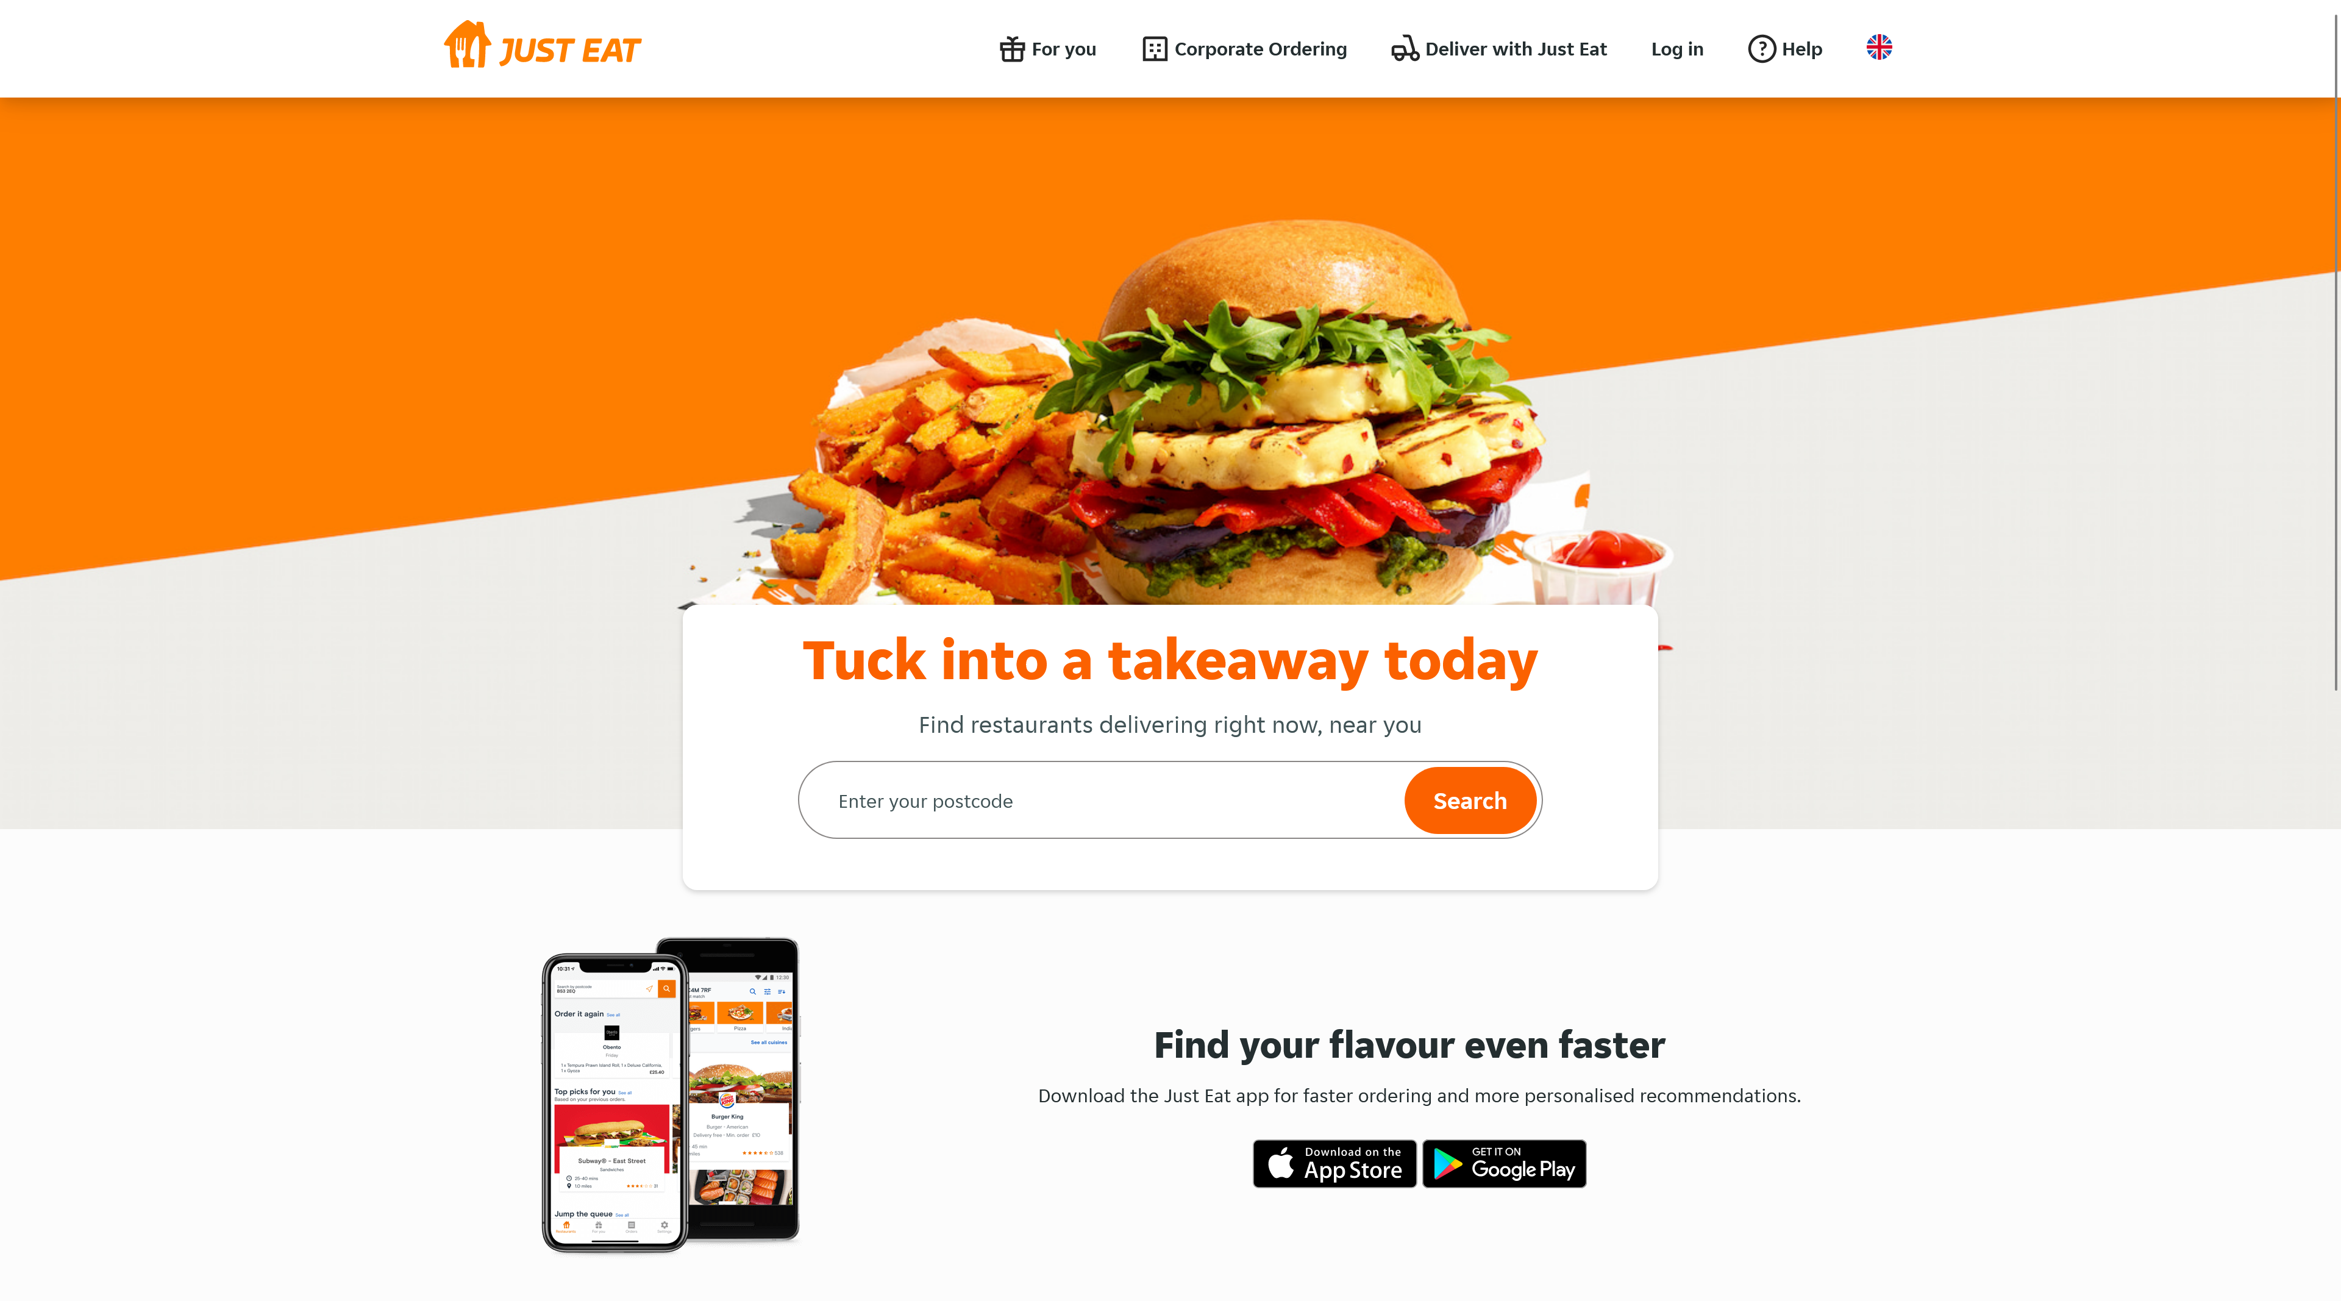

Slide 8
HTML5 Basics
Let’s get started

Slide 9
HTML Basics
HyperText Markup Language (HTML)
Not a programming language
Uses tags to display text and other data
Opening and closing tags
In essence: Plain text transformed by a browser
Only functional when structured.

Slide 10
Tags – building blocks of HTML
Essentials:
<!DOCTYPE html>
<html> </html>
<head> </head>
<title> </title>
<meta charset=“UTF-8”>
<body> </body>
Go build the essentials
Notes:
Uitleg geven bij tags (semantisch, locatie, parent-child, etc.)
Demo 1 – BasicHTML.html

Slide 11
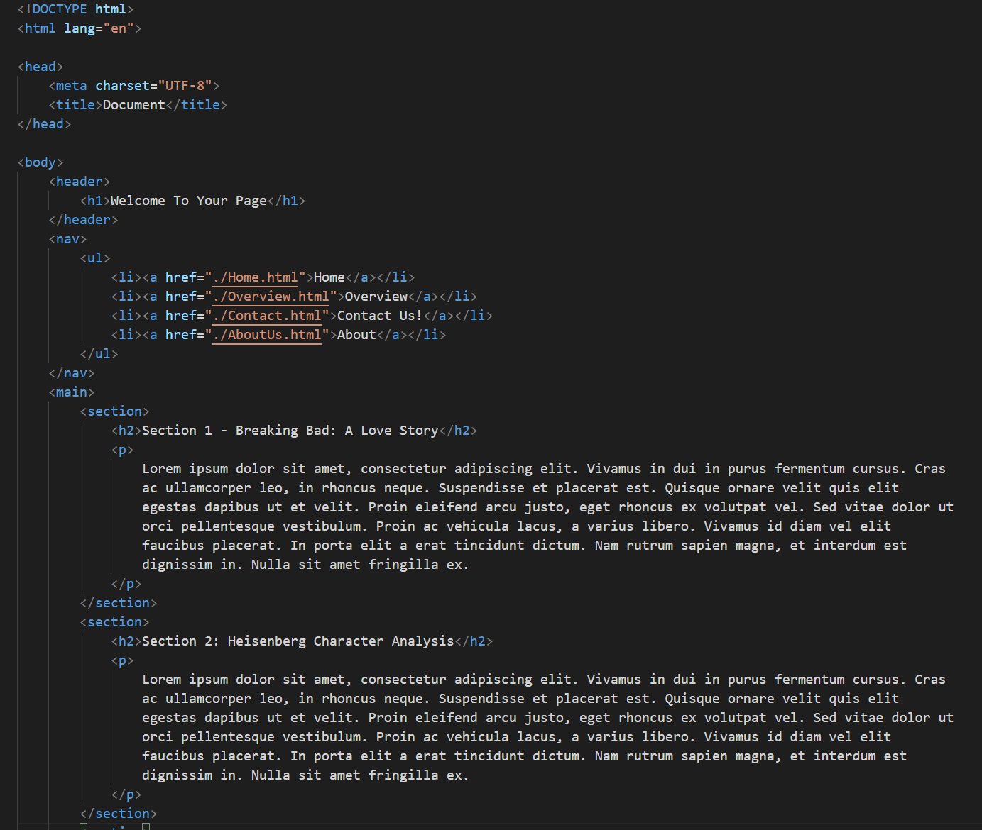
Demo 1

Slide 12
Tags – most common tags
Paragraph
<p> </p>
Headers
<h1> </h1> - <h2> </h2> - <h3> </h3> - etc.
Font adjustment
bold <b> </b>
italic <i> </i>
underline <u> </u>
Links
<a href=“linktopage.html”> </a>
Image
<img src=“../img/Newyear2023.jpeg” alt=“NewYear2024”>
Notes:
Aandachtspunten:
- Paragraph altijd om tekst. Tekst mag niet ‘vrij’ staan.
- Headers in verschillende niveaus (h1 – h6).
- Links: a staat voor anchor, href is attribuut. Href specifiek geeft locatie van link aan.
- Image: attribuut src nodig, alt is verplicht.

Slide 13
Tags – most common tags
Lists
<ul> </ul>
<ol> </ol>
ListItems
<li> </li>
Blank tags
<div> </div>
<span> </span>
Let’s update our page with these tags.

Slide 14
Demo 2

Slide 15

Tags – HTML5 Semantic Tags
<main> </main>
<nav> </nav>
<section> </section>
<article> </article>
<aside> </aside>
And more

Slide 16
Example File 1

Slide 17
Cascading Style Sheets (CSS)
Let’s add some style

Slide 18

Using Style Sheets
CSS is used to provide style to your HTML.
HTML contains the information that can be styled with CSS.
Style sheets manage aesthetics (color, fonts, etc.) and structure (placement, size).
Try to avoid mixing aesthetics and structure.

Slide 19
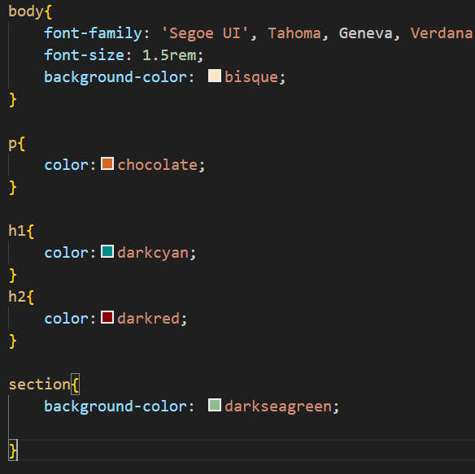
CSS – style sheet usage example
Style is appended to tags.
Any html tag is valid, including the HTML5 semantic tags.
Let’s give our page a stylish update.

Slide 20
WAIT!
We’ve forgotten a crucial part of style sheets.
We need to assign the stylesheet to the HTML file.
Since it’s information regarding the entire HTML file, we need to place it in the <head> tag.

Slide 21
Classes and Id’s
Class is a key-term used in CSS
It is used so that CSS lines can be applied to that class
This eliminates the issue of not being able to apply style to a single HTML tag.
This is how a class is defined in HTML: <div class=“mainLogo”></div>.
We make use of the class attribute, which can be applied to all tags.
In CSS, CSS lines can be applied to a class by calling the classname with a . (period) prefix: .mainLogo followed by the CSS lines
Example:
.mainLogo{
color:red;
};

Slide 22
Classes and Id’s
ID is another key-term used in CSS
It is also used so that CSS lines can be applied to it.
However only a single tag is allowed to have an ID with a specific name.
This is how an ID is defined in HTML: <div id=“mainLogo”></div>.
In CSS, CSS lines can be applied to a class by calling the id with a # (pound) prefix: #mainLogo followed by the CSS lines
Example:
#mainLogo{
color:blue;
};

Slide 23
Demo 3

Slide 24
PHP
Let’s get to… programming?

Slide 25

PHP – PHP Hypertext Preprocessor
PHP will add some dynamic possibilities to your webpage.
PHP is a scripting language created specifically for web solutions.
Many websites still make use of PHP including Facebook.

Slide 26
PHP – Let’s do it all in a demo
This demo will demonstrate
PHP files
Block tags
Echo/Print
Variables
and lastly Operators

Slide 27
Questions?
Next time – PHP Basics

